Slide 1


Slide 2



how to fix icub humanoid robot
Hardware troubleshooting of electronics and repair of mechanics
Software software configuration and installation
Calibration final calibration and functional testing

Slide 3
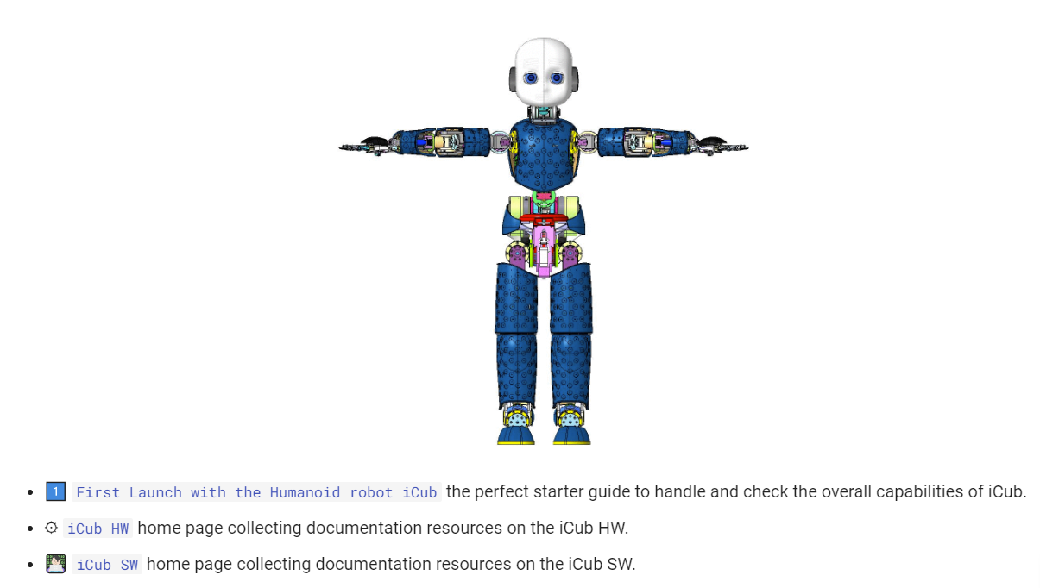
documentation
https://icub-tech-iit.github.io/documentation/

Slide 4
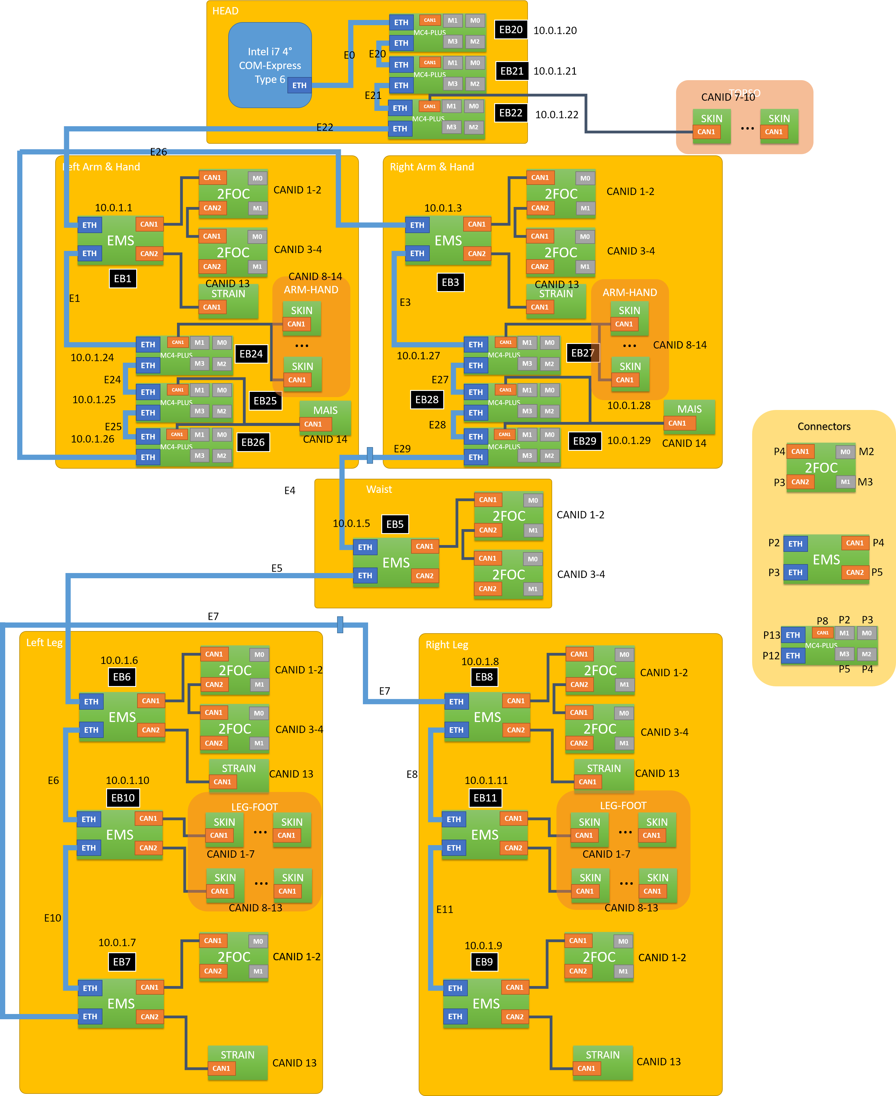
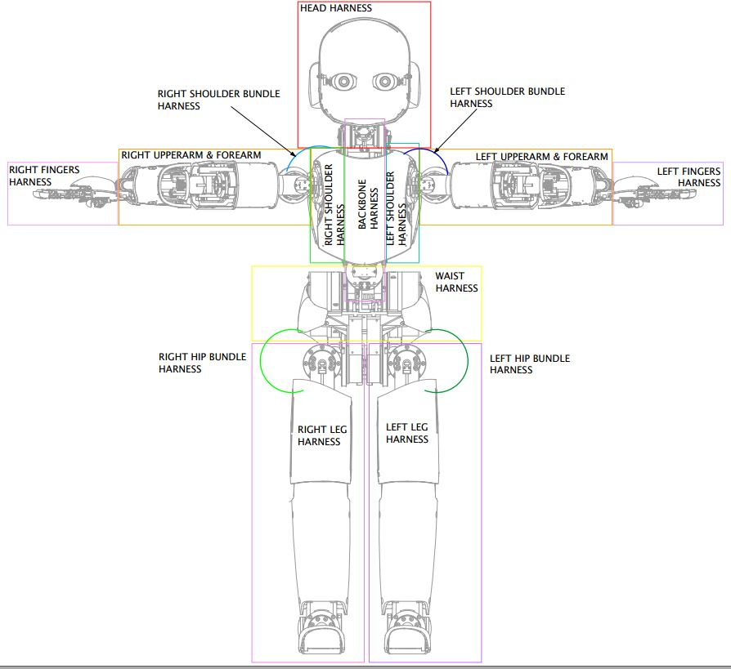
Robot architecture

Slide 5
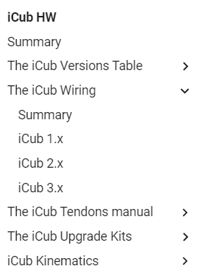
Wiring schematics
The purpose of this document is to give detailed documentation about the wiring of the robot, board and motor placement and the board connection.
The logic schematics consist of the logical and electrical connections between boards, sensors and motors. The harness schematics are the drawings of all the cables and bundles. The Motor&Board_Placement is the document where you can find the wireframe of the robot with all the electronic boards, motors and sensors labels.

Slide 6
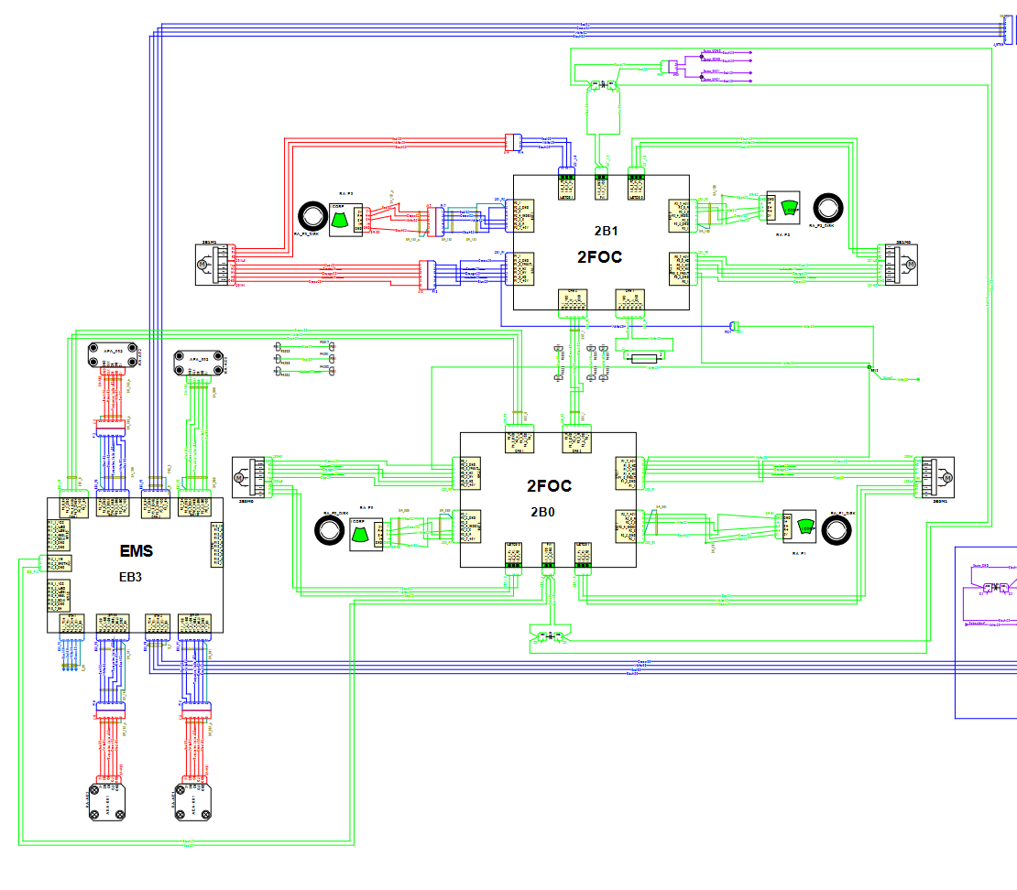
Logical schematics
Very useful for verification of logical connections between different boards.
Inside we find all the boards with their unique IDs and pinouts for the connectors.
Logical Schematics

Slide 7
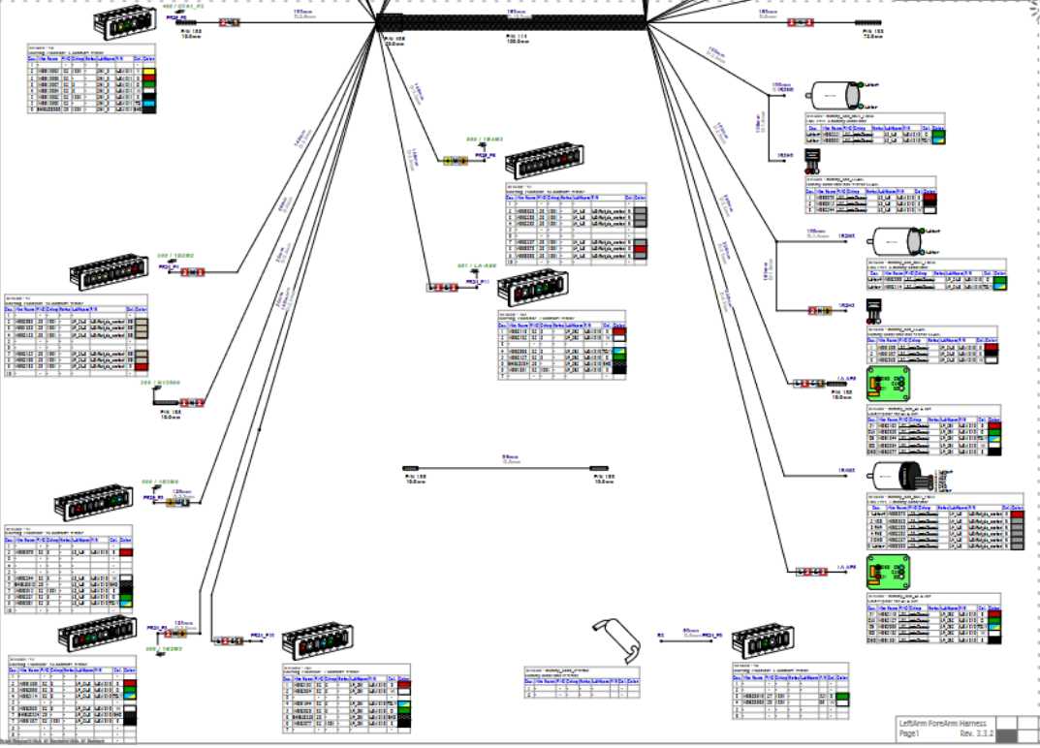
Harness schematics
More detailed description for connector wiring, adding code for electronic spare parts and MOLEX crimps.
Harness Schematics

Slide 8
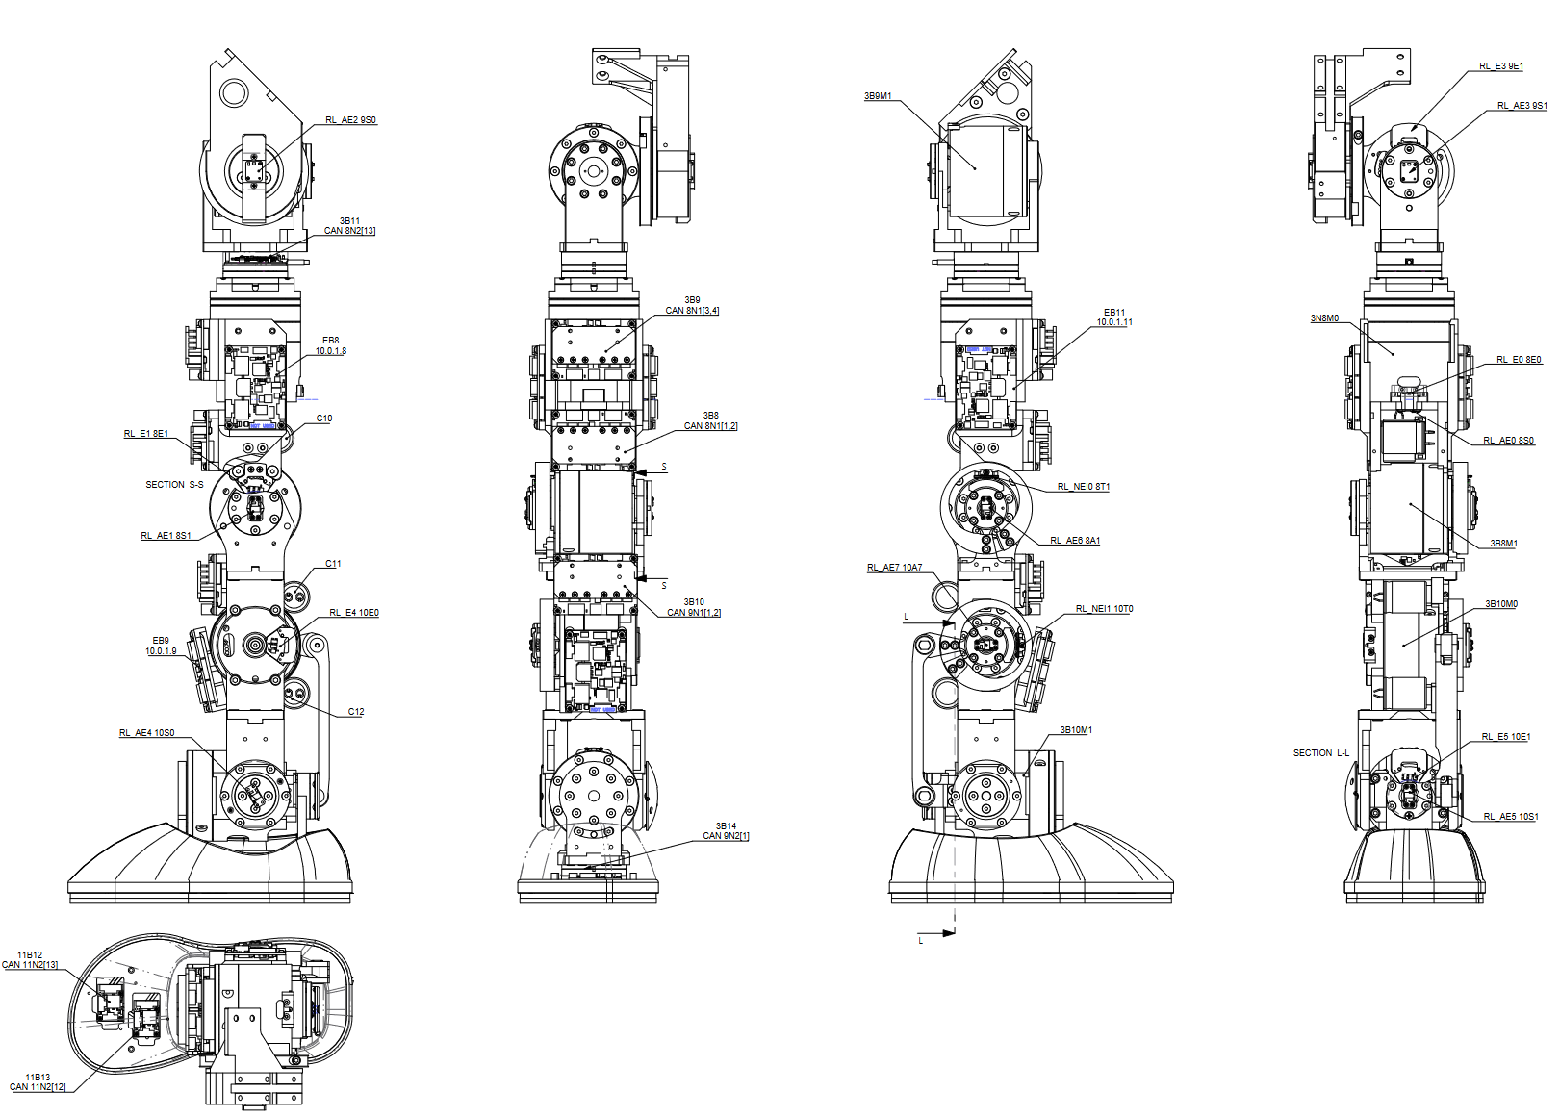
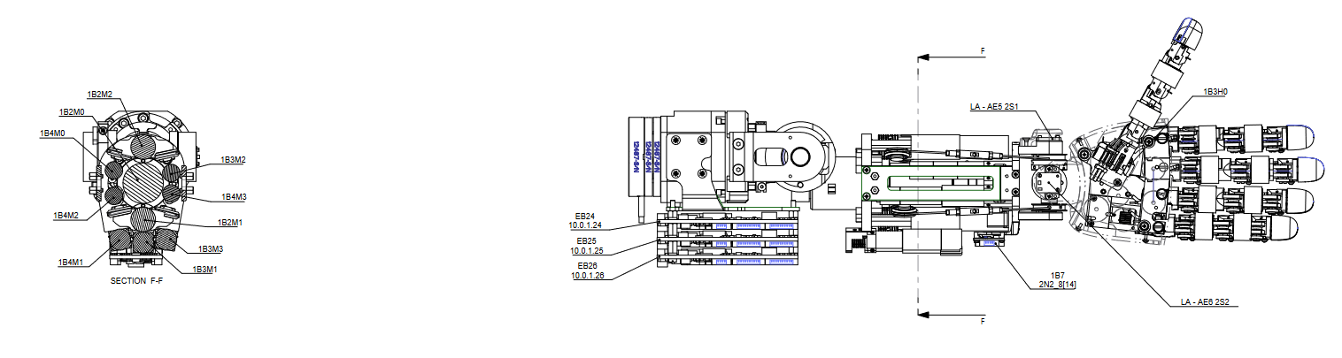
Motor&board placement
Mechanical drawings showing the placement of boards and sensors (e.g., FT)
Motor&Board placement

Slide 9

Electronics
Electronic Boards
Firmware
Debugging

Slide 10
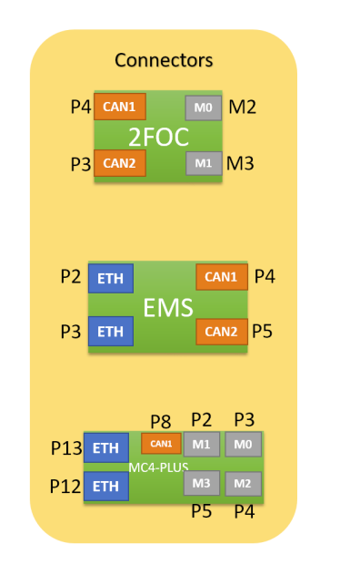
types of boards (v2.x)
INPUT:
EMS and MC4PLUS can be reached via ETH, while 2FOC can be reached via CAN protocol.
OUTPUT:
On the output to the 2FOCs we have the power part of the motors, and on the output to the EMSs the CAN connection with 2x2FOCs. For MC4-PLUS both CAN and Motors.

Slide 11
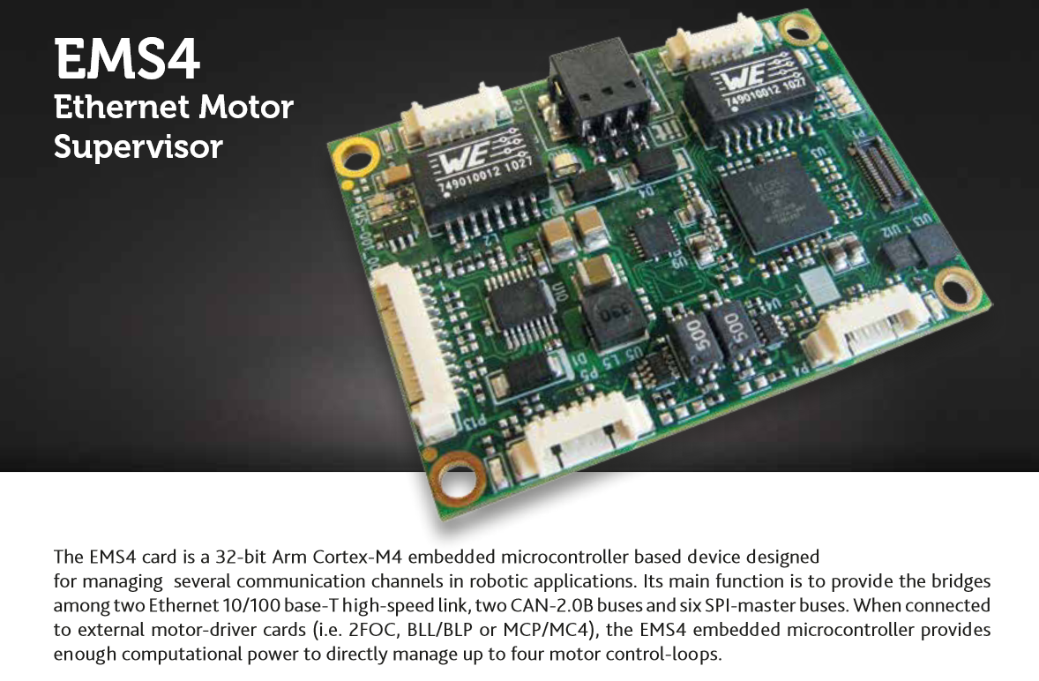
ems4

Slide 12
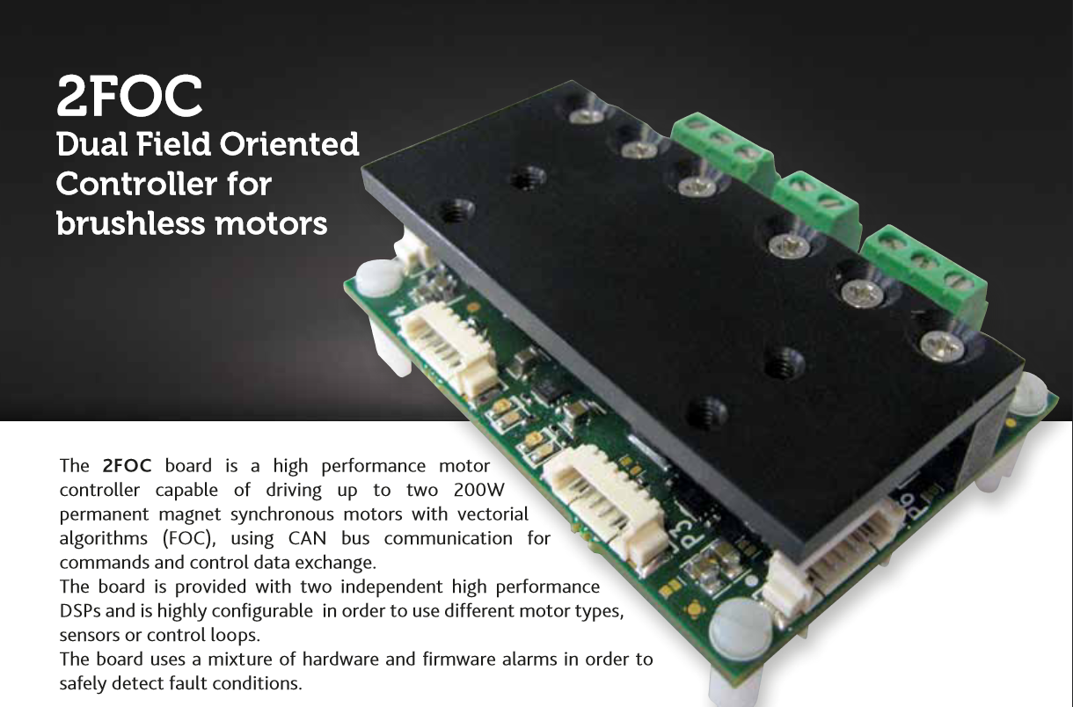
2foc

Slide 13
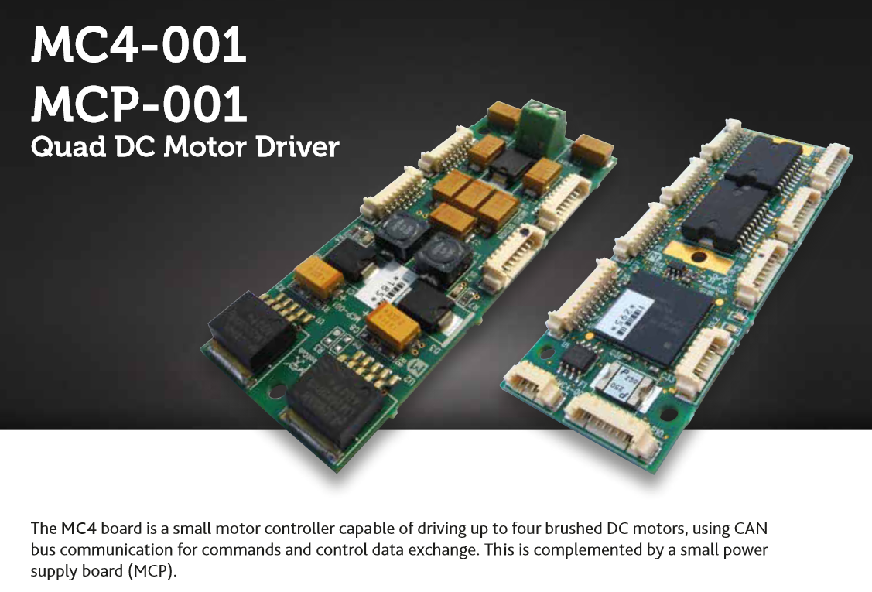
Mc4-Plus
Two different versions, but iCubValaparaiso01 mounts the latest

Slide 14
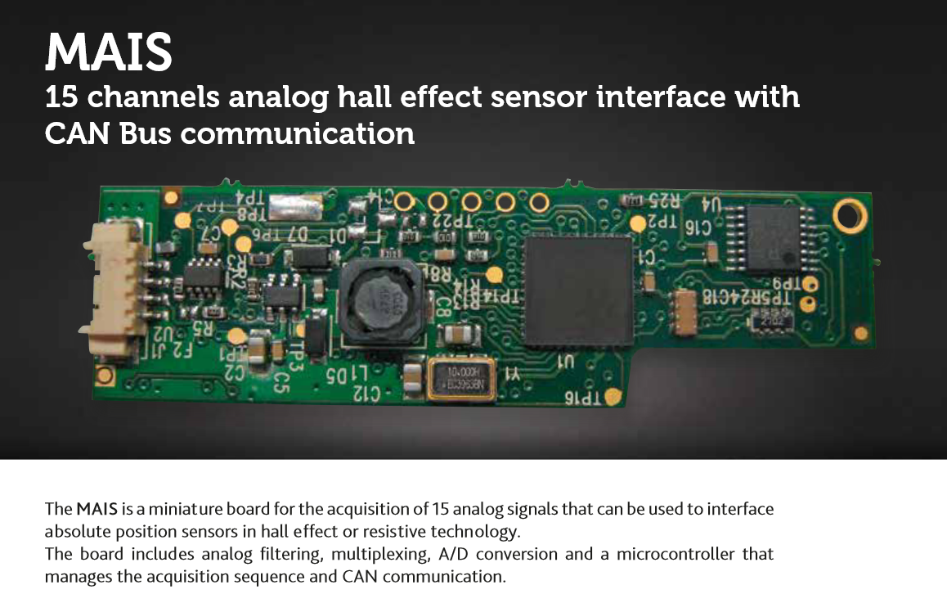
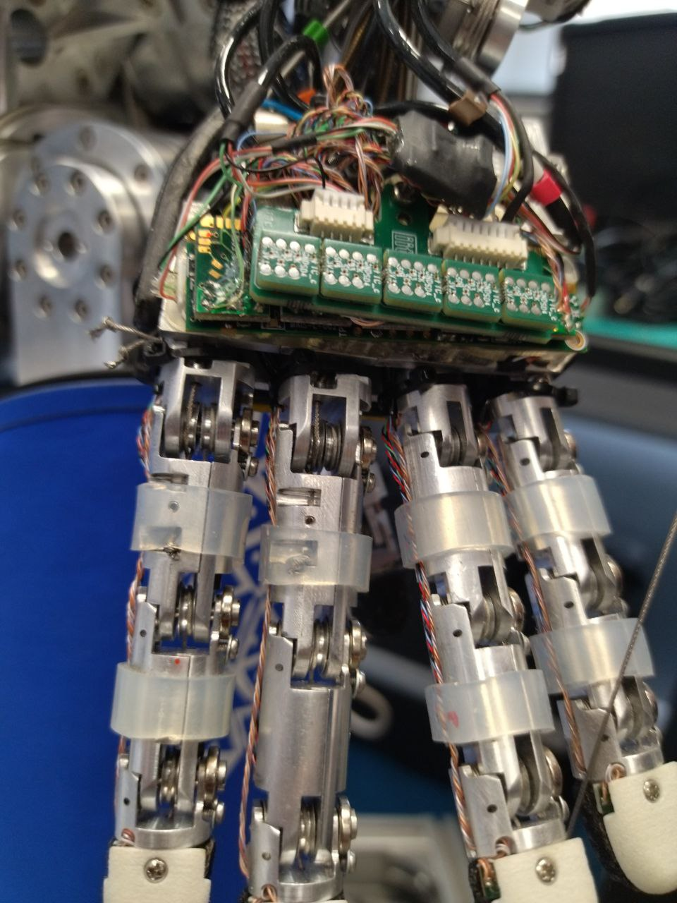
mais
Board deputed to handle position feedback from Hall sensors

Slide 15
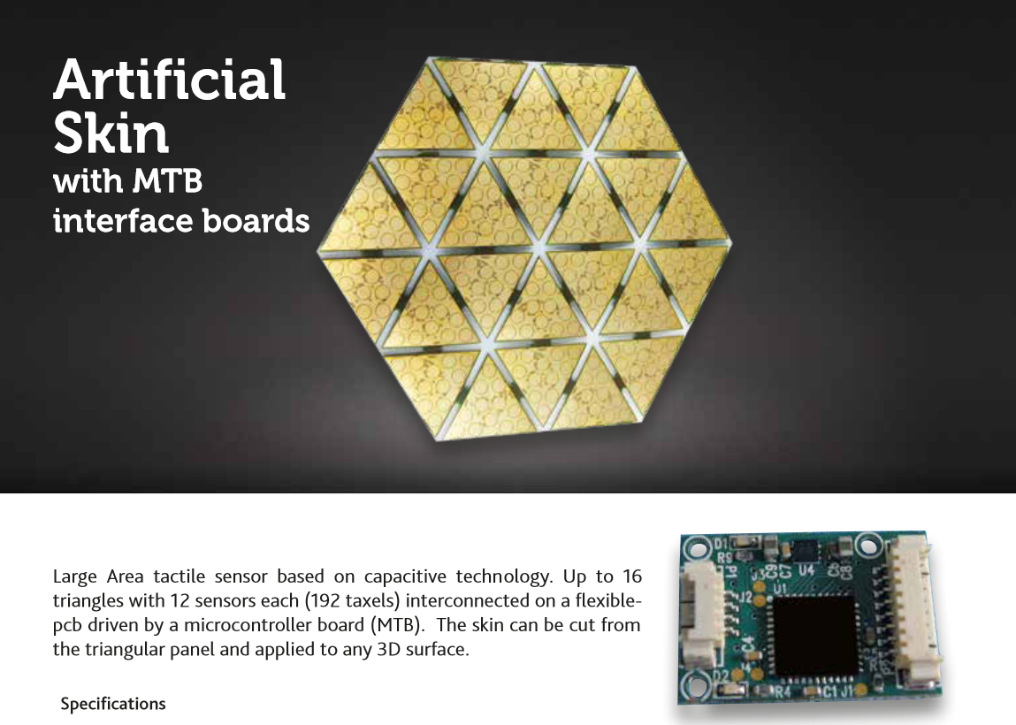
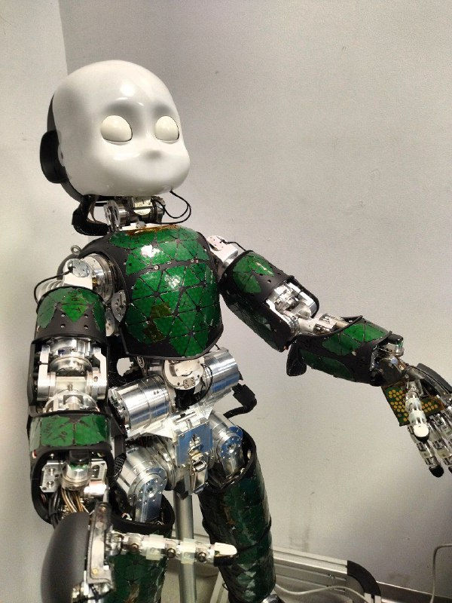
skin

Slide 16
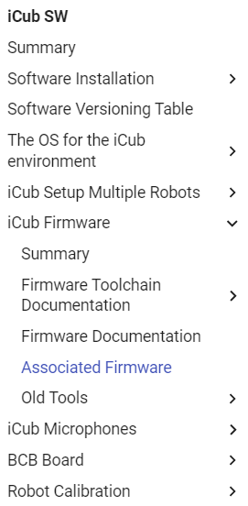
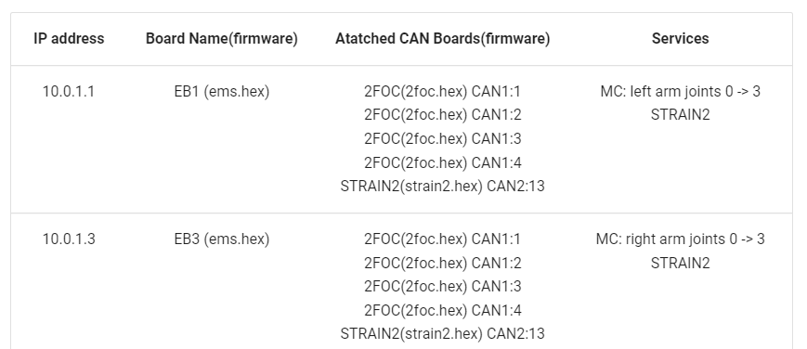
Associated firmware
This page reports the association board/address/firmware version either for CAN and ETH based robots.
We here describe the ETH and CAN-bus firmware association structure of the iCub v2.5 (Wiring > 3.2)

Slide 17
Firmware updater (icub-head)
With the FirmwareUpdater application it is possible to perform GUI-based FW update on both CAN and ETH-based robots; the commonly used functionalities are:
Upload application firmware both on ETH boards and CAN boards
Change the IP addrress for ethernet based boards
Change the CAN ID for the CAN based boards
Update the bootloader (advanced option)
Access to the F/T sensors calibration data of the STTRAIN/STRAIN2
FirwareUpdater Documentation

Slide 18
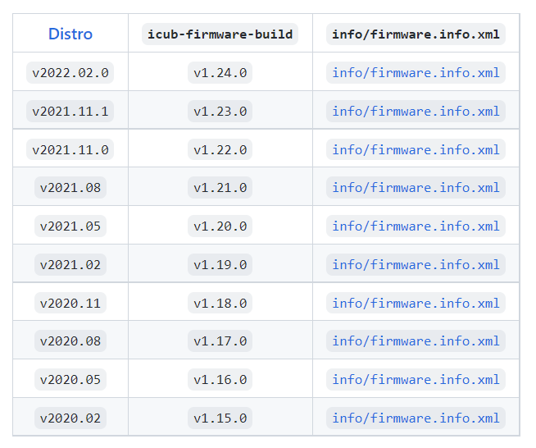
Icub-firmware-build
This repository contains builds of the firmware for the low-level boards of the iCub robot. The firmwares are obtained compiling the source code in icub-firmware and icub-firmware-shared using board-specific tools.

Slide 19
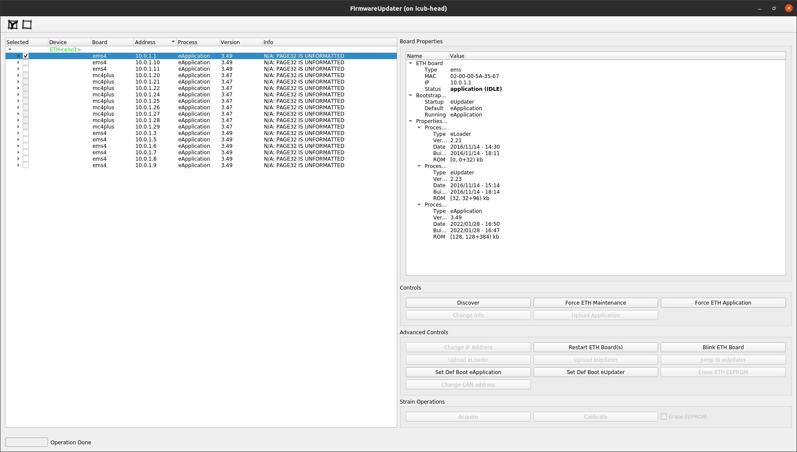
firmware version debugging
ssh –X icub-head
FirmwareUpdater -a

Slide 20

Hands on!
Fingertip replacement +
Crimping

Slide 21

mechanics
Tendons
Neck
Wrist
Hands

Slide 22
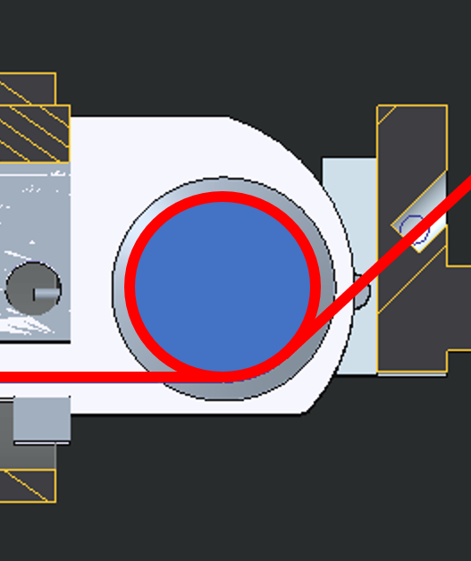
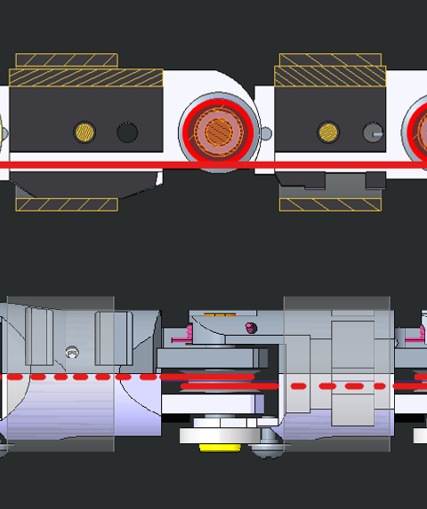
Tendons
iCub Tendons contains the ultimate step-by-step guide on how to replace broken or out of place tendons of the iCub. It includes also some tutorials on how to build forearms and the overall tendons constituting iCub.

Slide 23
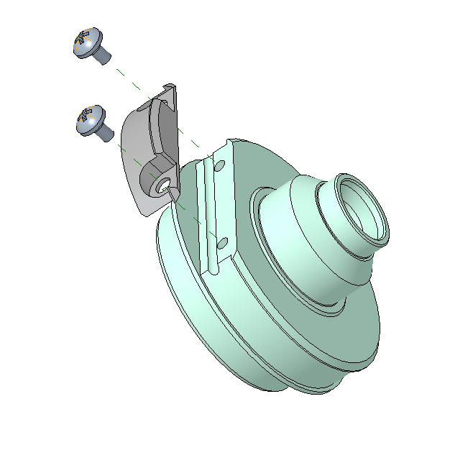
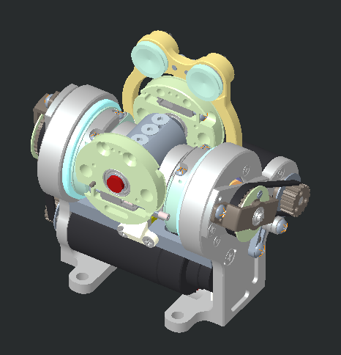
Neck (passive)
The second release of the neck has 2 tendons and two differential joints to actuate the first 2 DoFs of the neck compared to the 2 serial joints of the previous version of the neck (V1).

Slide 24
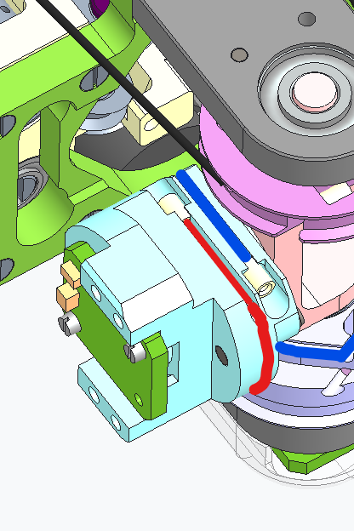
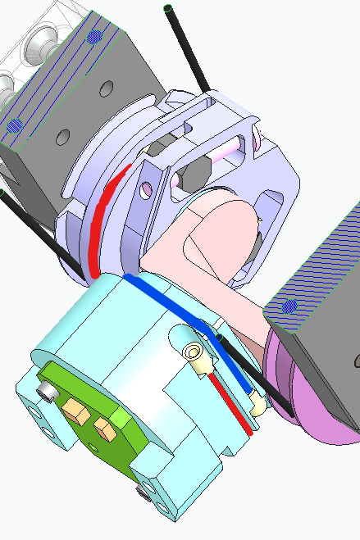
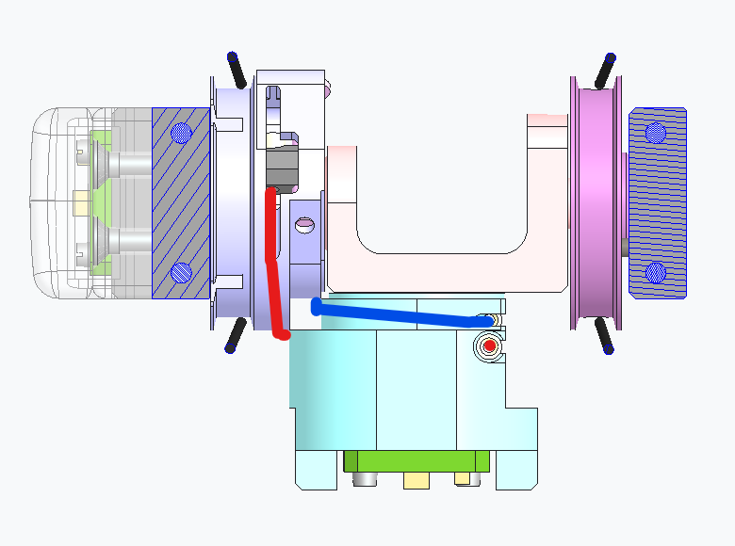
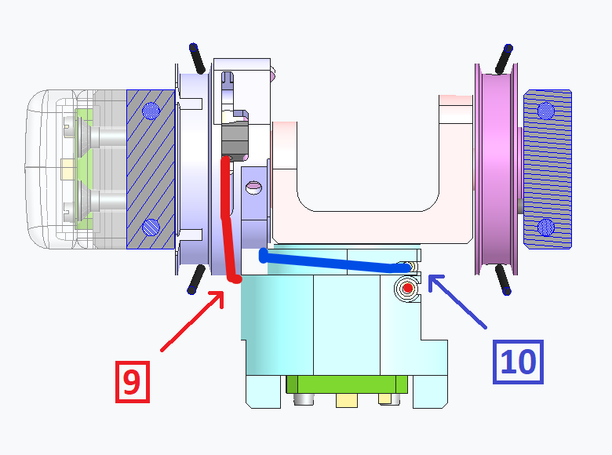
Right Wrist (passive)
Documentation

Slide 25
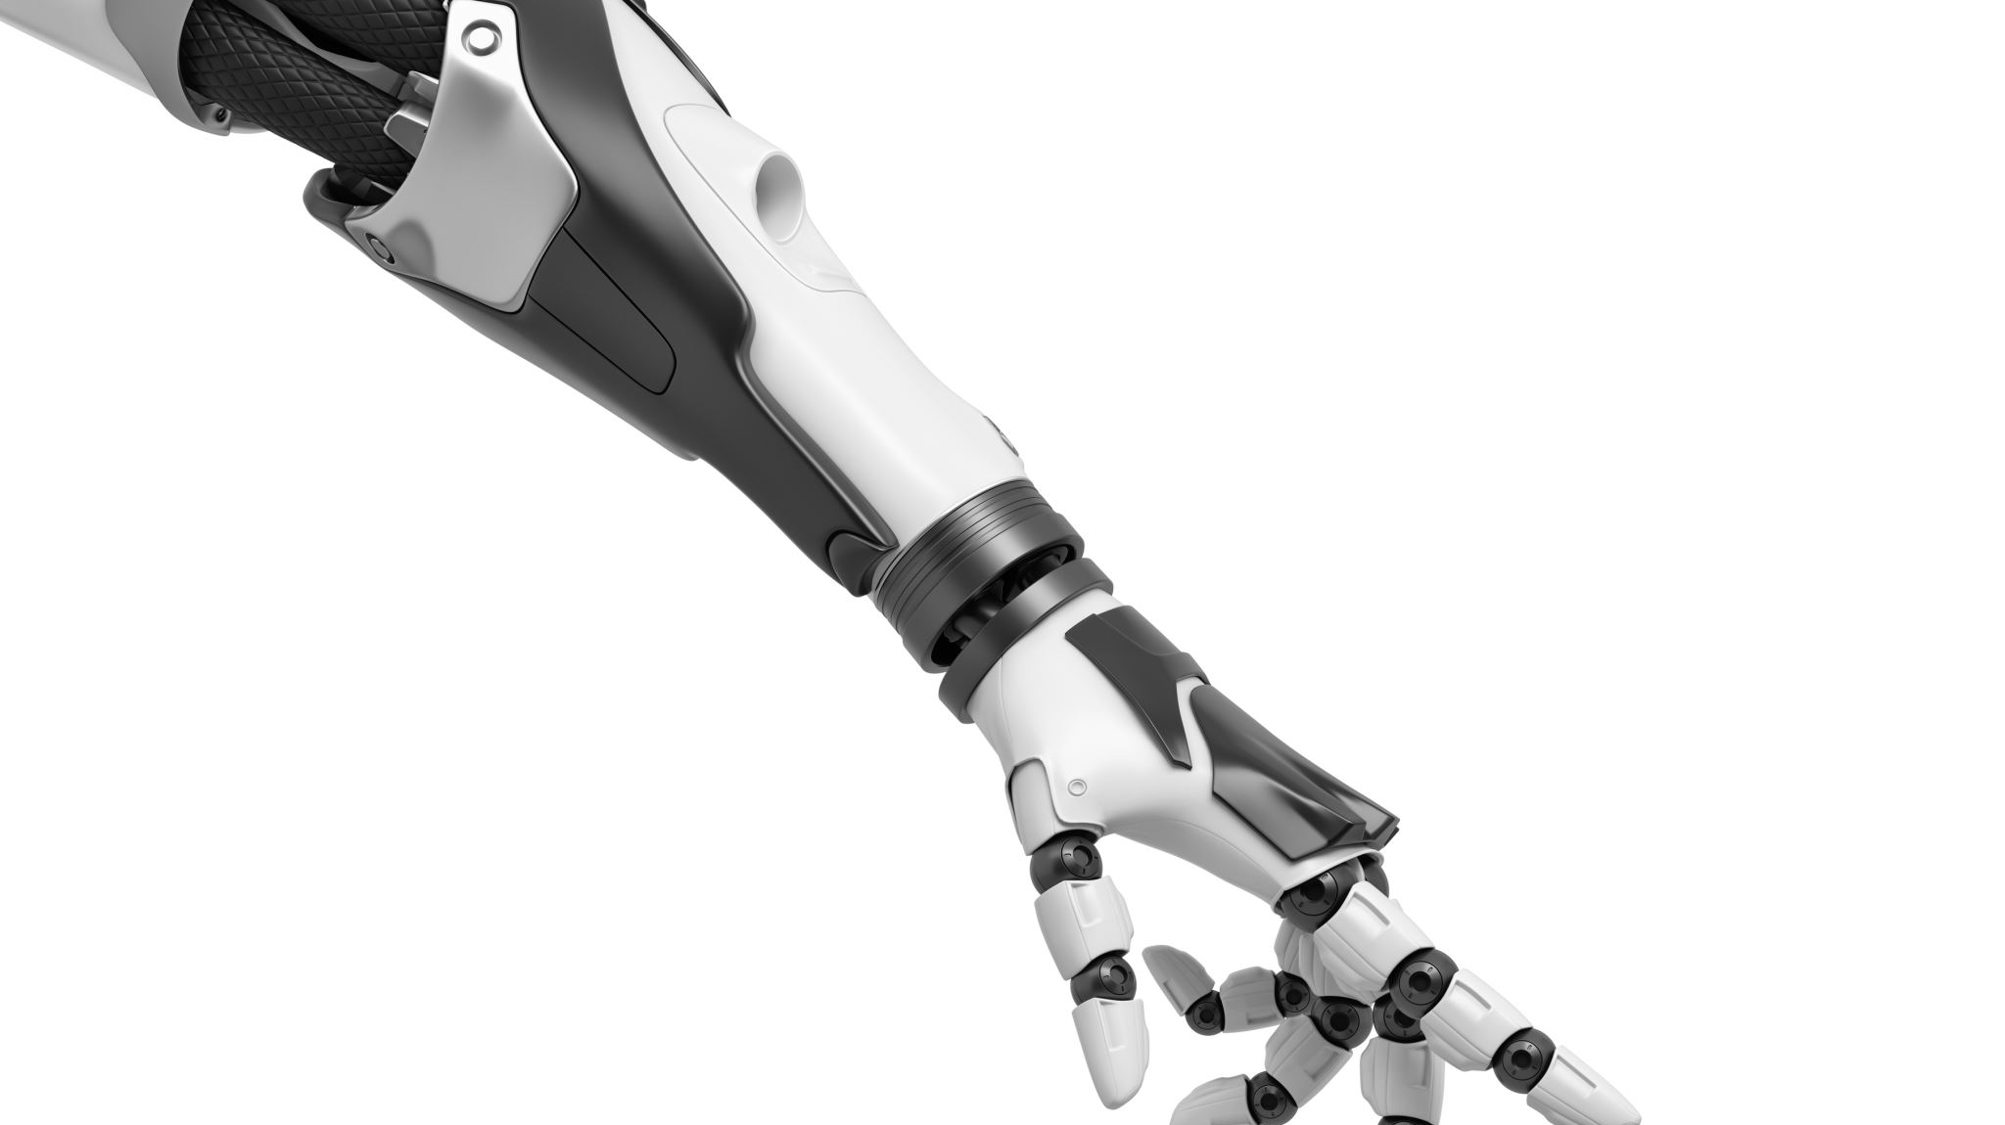
Hands on wrist joints

Slide 26
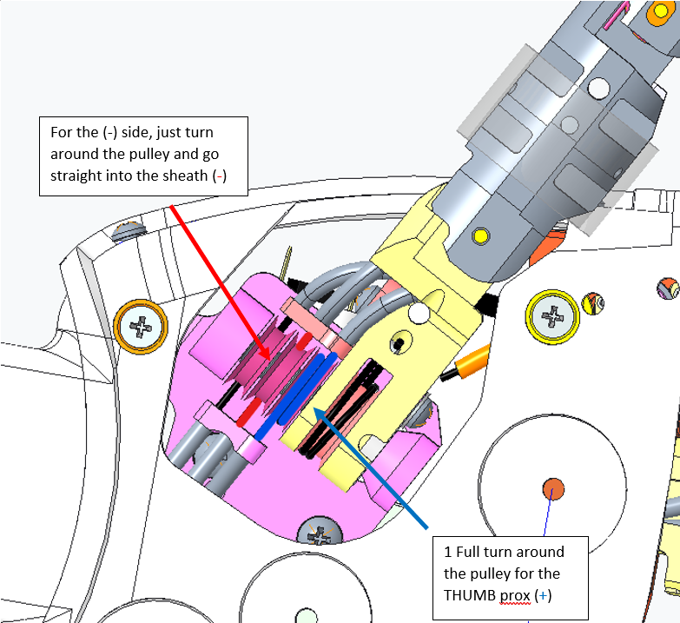
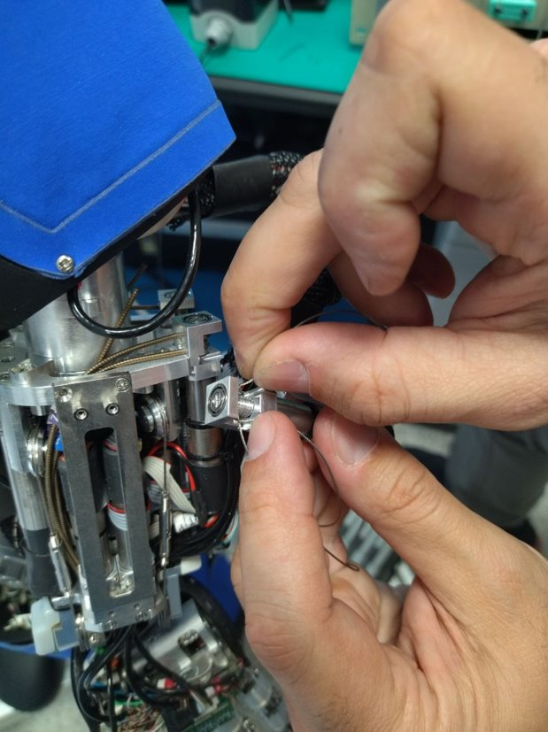
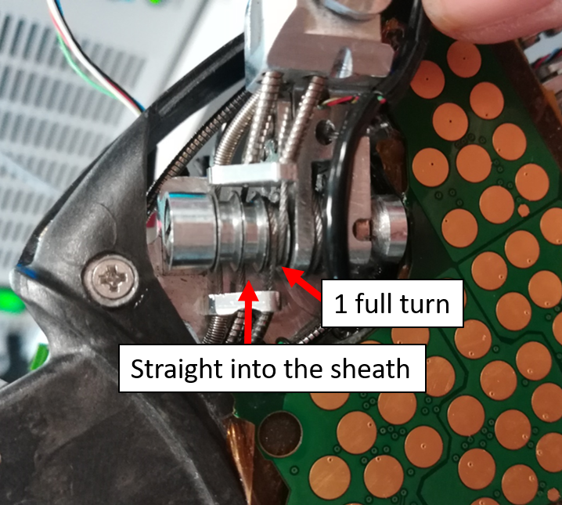
Hand joints
Rules of Thumb for a good start

Slide 27

Hands on distal joints

Slide 28

Software
Yarpmanager
Robots configuration
Read raw encoder values
Calibration

Slide 29
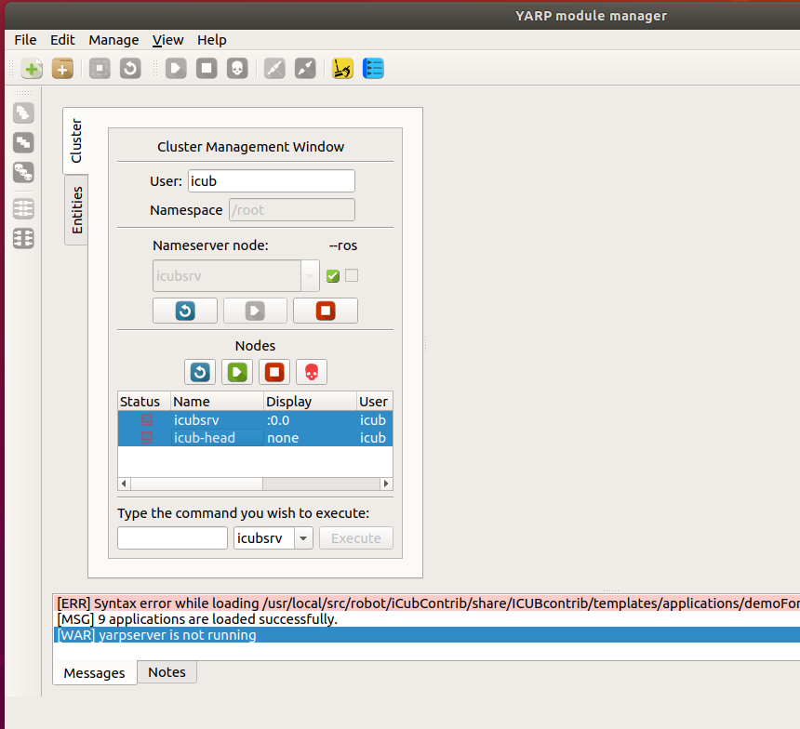
Running modules on yarpmanager
Connect the clusters

Slide 30
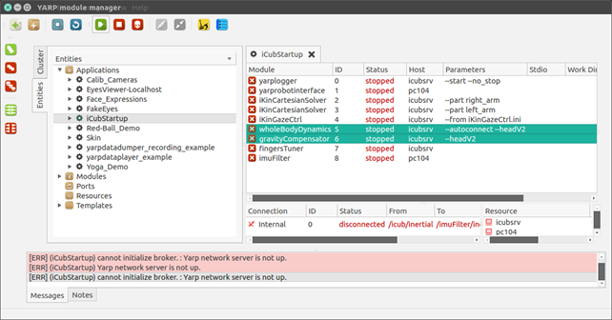
Icub_startup
Here we find all the main modules to start iCub logging (yarplogger) and the yarprobotinterface

Slide 31

Folder structure

Slide 32
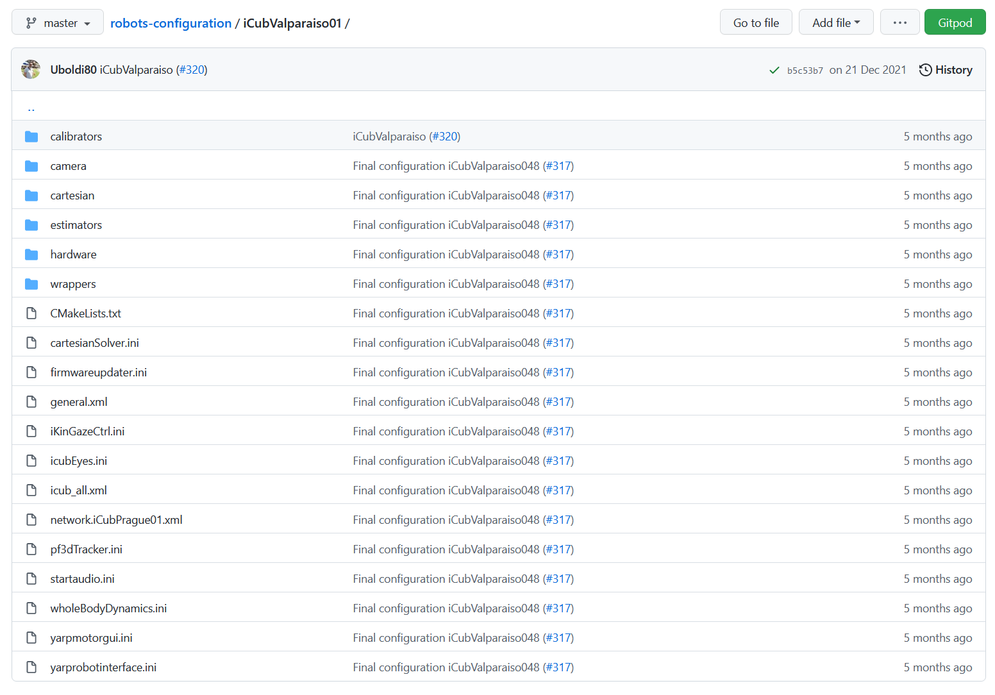
Robots configuration
Repository dedicated to collecting all configuration files for iCub robots.
Managed on GitHub and any changes to the robot must also be updated online.

Slide 33
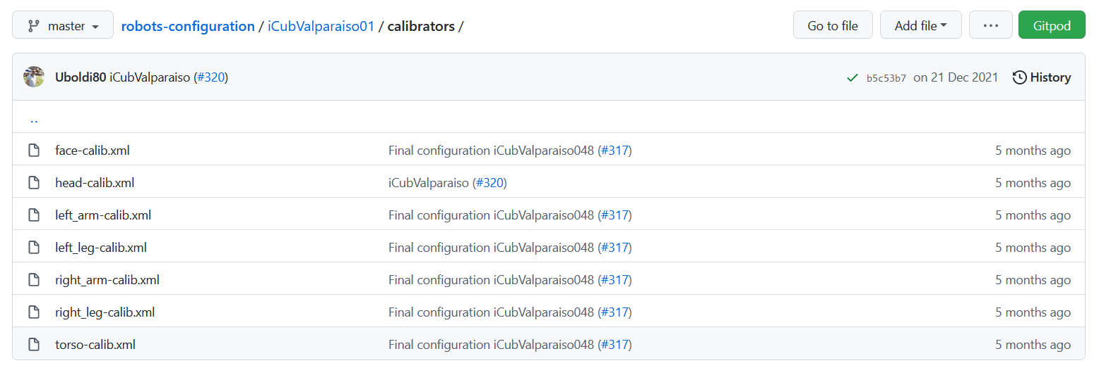
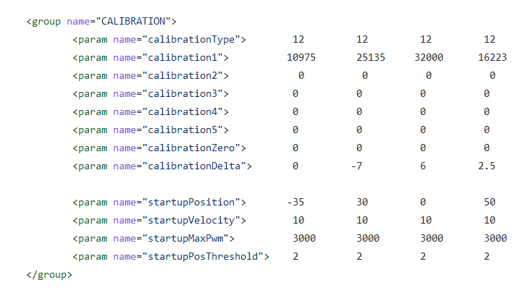
calibrators
One configuration file for each main part of the robot
Standardized format (XML)
You need to get the raw values from the encoders
Calibration Types Additional Details

Slide 34
Get Raw encoder values
General procedure for retrieving calibration parameters
1) First of all, you need to be sure that boards have been reset after last calibration. If not, please switch off and switch on boards
2) In the general.xml file set both “useRawEncoderValue” and “skipCalibration” parameters to true
3) Press the fault. So, you are sure the procedure is safe
4) Launch yarprobotinterface. You will see that yarprobotInterface tell you to press fault button and waits until the user press enter.
5) Start the calibration procedure depending on calibration type.

Slide 35
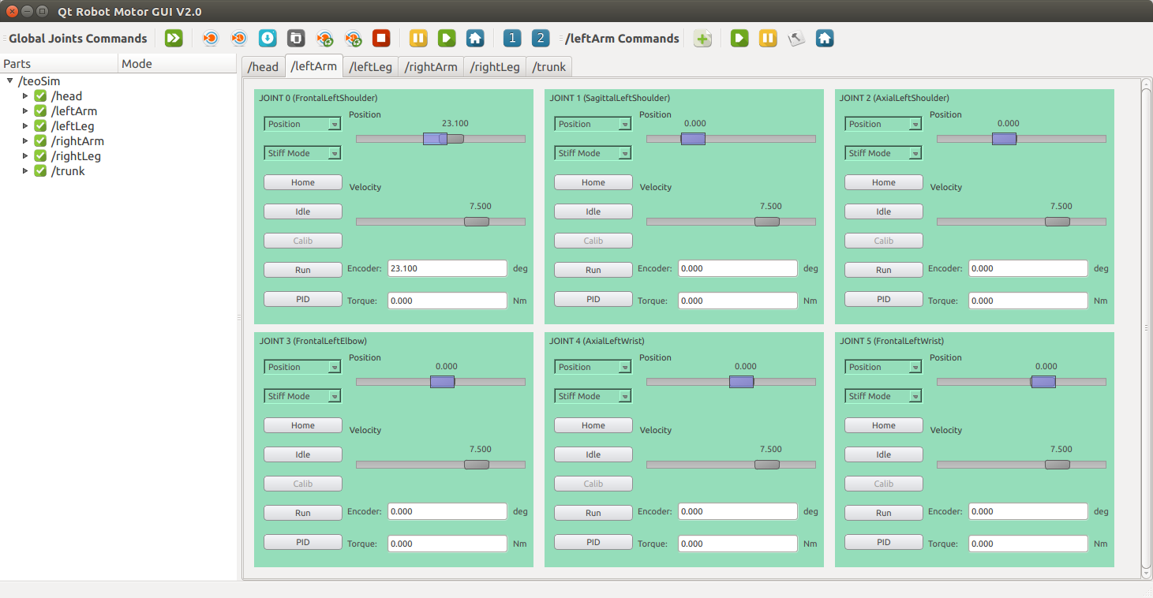
Yarpmotorgui (special mode)
Many joints might pop up in gray or red, but this is normal, and we are only interested in the values read by the encoders.

Slide 36
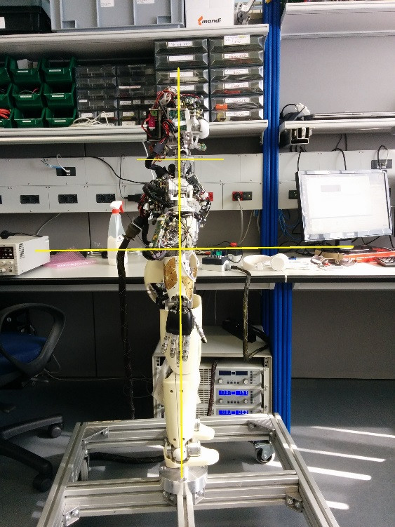
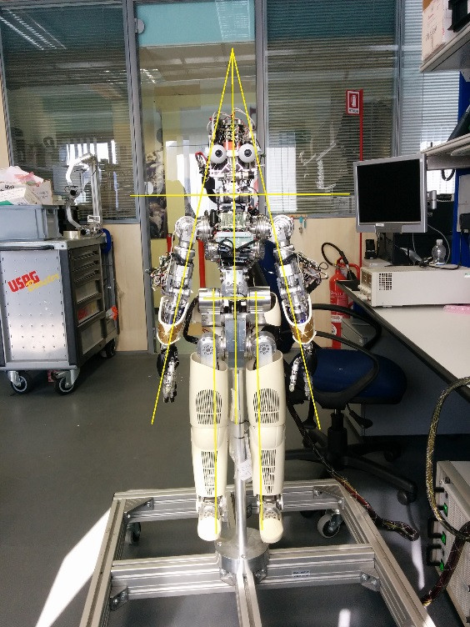
Zero calibration
Link to Documentation

Slide 37
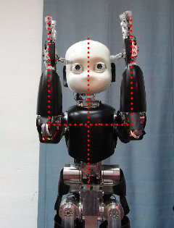
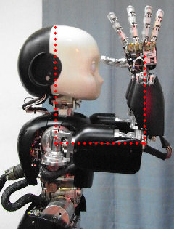
Arms Fine calibration
Link to Documentation

Slide 38

Questions

Slide 39
The only robot that doesn't break
Is the one that is not used.
-Julien Jenvrin

